Slide 1

OPEN
DATA
SCIENCE
CONFERENCE
@ODSC

Slide 2
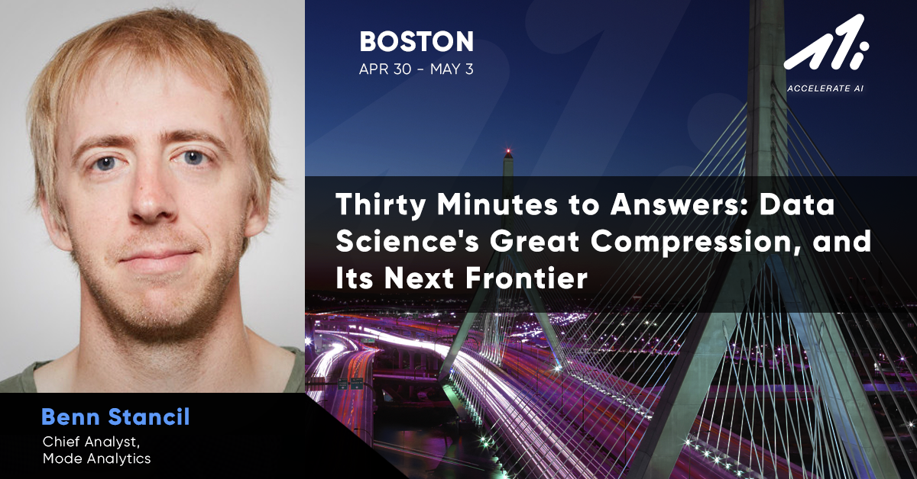

Slide 3


30 minutes to answers
Data science's Great Compression, and its next frontier
Benn Stancil
Mode

Slide 4

Trends from our customers

Slide 5
The Great
Compression

Slide 6
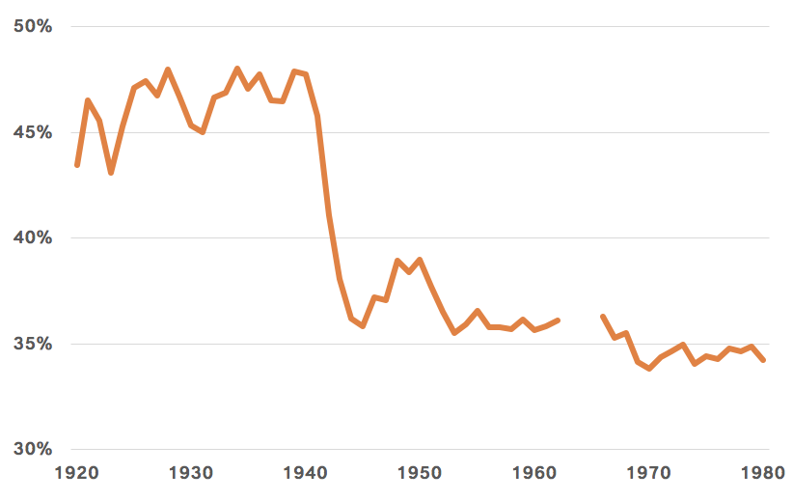
U.S. income share of top 10%
Source: World Income Database

Slide 7
U.S. income share of top 10%
The Great Compression
Source: World Income Database

Slide 8
Data science is going through its own Great Compression

Slide 9
A story
about leads

Slide 10


Slide 11
A lead scoring model in 2014
Notes:
Sources:
http://www.oracle.com/us/corporate/analystreports/esg-getting-real-bigdata-2228170.pdf
https://www.cooladata.com/blog/true-cost
Look at all these things investors want. These are the ways that investors evaluate startups. It’s intimidating.

Slide 12
A lead scoring model in 2014
Usage data
Lead enrichment
Sales interactions
Sources: Enterprise Strategy Group, SAS, Cooladata
Notes:
Sources:
http://www.oracle.com/us/corporate/analystreports/esg-getting-real-bigdata-2228170.pdf
https://www.cooladata.com/blog/true-cost
Look at all these things investors want. These are the ways that investors evaluate startups. It’s intimidating.

Slide 13
A lead scoring model in 2014
$100k for DB software
Usage data
Lead enrichment
Data warehouse
Sales interactions
Sources: Enterprise Strategy Group, SAS, Cooladata
Notes:
Sources:
http://www.oracle.com/us/corporate/analystreports/esg-getting-real-bigdata-2228170.pdf
https://www.cooladata.com/blog/true-cost
Look at all these things investors want. These are the ways that investors evaluate startups. It’s intimidating.

Slide 14
A lead scoring model in 2014
$100k hardware and infrastructure
Usage data
Lead enrichment
Data warehouse
Sales interactions
Sources: Enterprise Strategy Group, SAS, Cooladata
Notes:
Sources:
http://www.oracle.com/us/corporate/analystreports/esg-getting-real-bigdata-2228170.pdf
https://www.cooladata.com/blog/true-cost
Look at all these things investors want. These are the ways that investors evaluate startups. It’s intimidating.

Slide 15
A lead scoring model in 2014
$250k for ETL engineers
Usage data
Lead enrichment
Data warehouse
Sales interactions
Sources: Enterprise Strategy Group, SAS, Cooladata
Notes:
Sources:
http://www.oracle.com/us/corporate/analystreports/esg-getting-real-bigdata-2228170.pdf
https://www.cooladata.com/blog/true-cost
Look at all these things investors want. These are the ways that investors evaluate startups. It’s intimidating.

Slide 16
A lead scoring model in 2014
$50k for SAS or manage a custom platform
Usage data
Lead enrichment
Analytics + data science platform
Data warehouse
Sales interactions
Sources: Enterprise Strategy Group, SAS, Cooladata
Notes:
Sources:
http://www.oracle.com/us/corporate/analystreports/esg-getting-real-bigdata-2228170.pdf
https://www.cooladata.com/blog/true-cost
Look at all these things investors want. These are the ways that investors evaluate startups. It’s intimidating.

Slide 17
A lead scoring model in 2014
Home-built ML models
Usage data
Lead enrichment
Analytics + data science platform
Data warehouse
Sales interactions
Sources: Enterprise Strategy Group, SAS, Cooladata
Notes:
Sources:
http://www.oracle.com/us/corporate/analystreports/esg-getting-real-bigdata-2228170.pdf
https://www.cooladata.com/blog/true-cost
Look at all these things investors want. These are the ways that investors evaluate startups. It’s intimidating.

Slide 18
A lead scoring model in 2014
Interacting with business stakeholders
Usage data
Lead enrichment
Analytics + data science platform
Distribute list to sales reps
Data warehouse
Sales interactions
Notes:
Sources:
http://www.oracle.com/us/corporate/analystreports/esg-getting-real-bigdata-2228170.pdf
https://www.cooladata.com/blog/true-cost
Look at all these things investors want. These are the ways that investors evaluate startups. It’s intimidating.

Slide 19
To sell to the Glengarry leads...
Our ETL jobs have to be reliable
1...
Notes:
Source: https://medium.com/signalfire-fund/top-5-metrics-vcs-look-at-for-series-a-b-c-c6a0171fd200
Look at all these things investors want. These are the ways that investors evaluate startups. It’s intimidating.

Slide 20
To sell to the Glengarry leads...
Our ETL jobs have to be reliable
1...
Our database needs to be maintained
2...
Notes:
Source: https://medium.com/signalfire-fund/top-5-metrics-vcs-look-at-for-series-a-b-c-c6a0171fd200
Look at all these things investors want. These are the ways that investors evaluate startups. It’s intimidating.

Slide 21
To sell to the Glengarry leads...
Our ETL jobs have to be reliable
1...
Our database needs to be maintained
2...
Our model has to be well-written
3...
Notes:
Source: https://medium.com/signalfire-fund/top-5-metrics-vcs-look-at-for-series-a-b-c-c6a0171fd200
Look at all these things investors want. These are the ways that investors evaluate startups. It’s intimidating.

Slide 22
To sell to the Glengarry leads...
Our ETL jobs have to be reliable
1...
Our database needs to be maintained
2...
Our model has to be well-written
3...
The sales team has to use our results
4...
Notes:
Source: https://medium.com/signalfire-fund/top-5-metrics-vcs-look-at-for-series-a-b-c-c6a0171fd200
Look at all these things investors want. These are the ways that investors evaluate startups. It’s intimidating.

Slide 23
To sell to the Glengarry leads...
We solve hard business problems by building data infrastructure and statistical applications
Notes:
Source: https://medium.com/signalfire-fund/top-5-metrics-vcs-look-at-for-series-a-b-c-c6a0171fd200
Look at all these things investors want. These are the ways that investors evaluate startups. It’s intimidating.

Slide 24
To sell to the Glengarry leads...
Analytical and business expertise
Engineering and development
Statistics
Notes:
Source: https://medium.com/signalfire-fund/top-5-metrics-vcs-look-at-for-series-a-b-c-c6a0171fd200
Look at all these things investors want. These are the ways that investors evaluate startups. It’s intimidating.

Slide 25

To sell to the Glengarry leads...
Analytical and business expertise
Engineering and development
Statistics
Notes:
Source: https://medium.com/signalfire-fund/top-5-metrics-vcs-look-at-for-series-a-b-c-c6a0171fd200
Look at all these things investors want. These are the ways that investors evaluate startups. It’s intimidating.

Slide 26
The cost of data science
$500k a year
2014

Slide 27
The cost of data science
$500k a year
Months of work
2014

Slide 28
The cost of data science
$500k a year
Months of work
A lot of expertise
2014

Slide 29
A lead scoring model today
Notes:
Sources:
http://www.oracle.com/us/corporate/analystreports/esg-getting-real-bigdata-2228170.pdf
https://www.cooladata.com/blog/true-cost
Look at all these things investors want. These are the ways that investors evaluate startups. It’s intimidating.

Slide 30
A lead scoring model today
Usage data
Lead enrichment
Analytics + data science platform
Distribute list to sales reps
Data warehouse
Sales interactions
Notes:
Sources:
http://www.oracle.com/us/corporate/analystreports/esg-getting-real-bigdata-2228170.pdf
https://www.cooladata.com/blog/true-cost
Look at all these things investors want. These are the ways that investors evaluate startups. It’s intimidating.

Slide 31
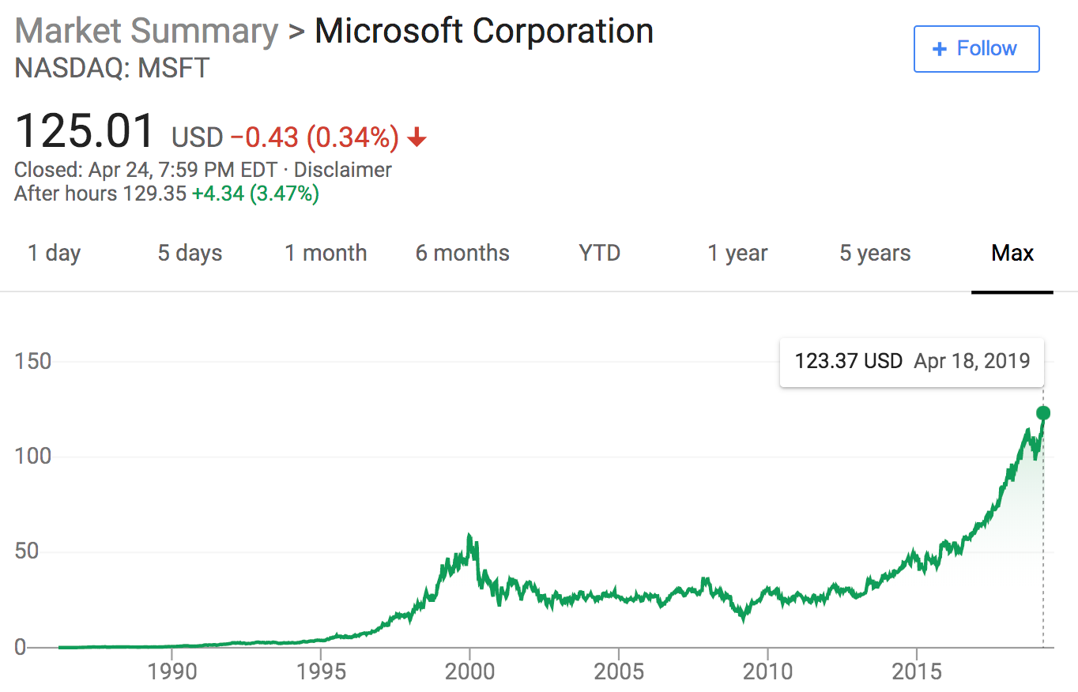
Source: Google Finance
Notes:
Sales jumped 14% in the latest quarter, driven by the company’s transition to the public cloud

Slide 32
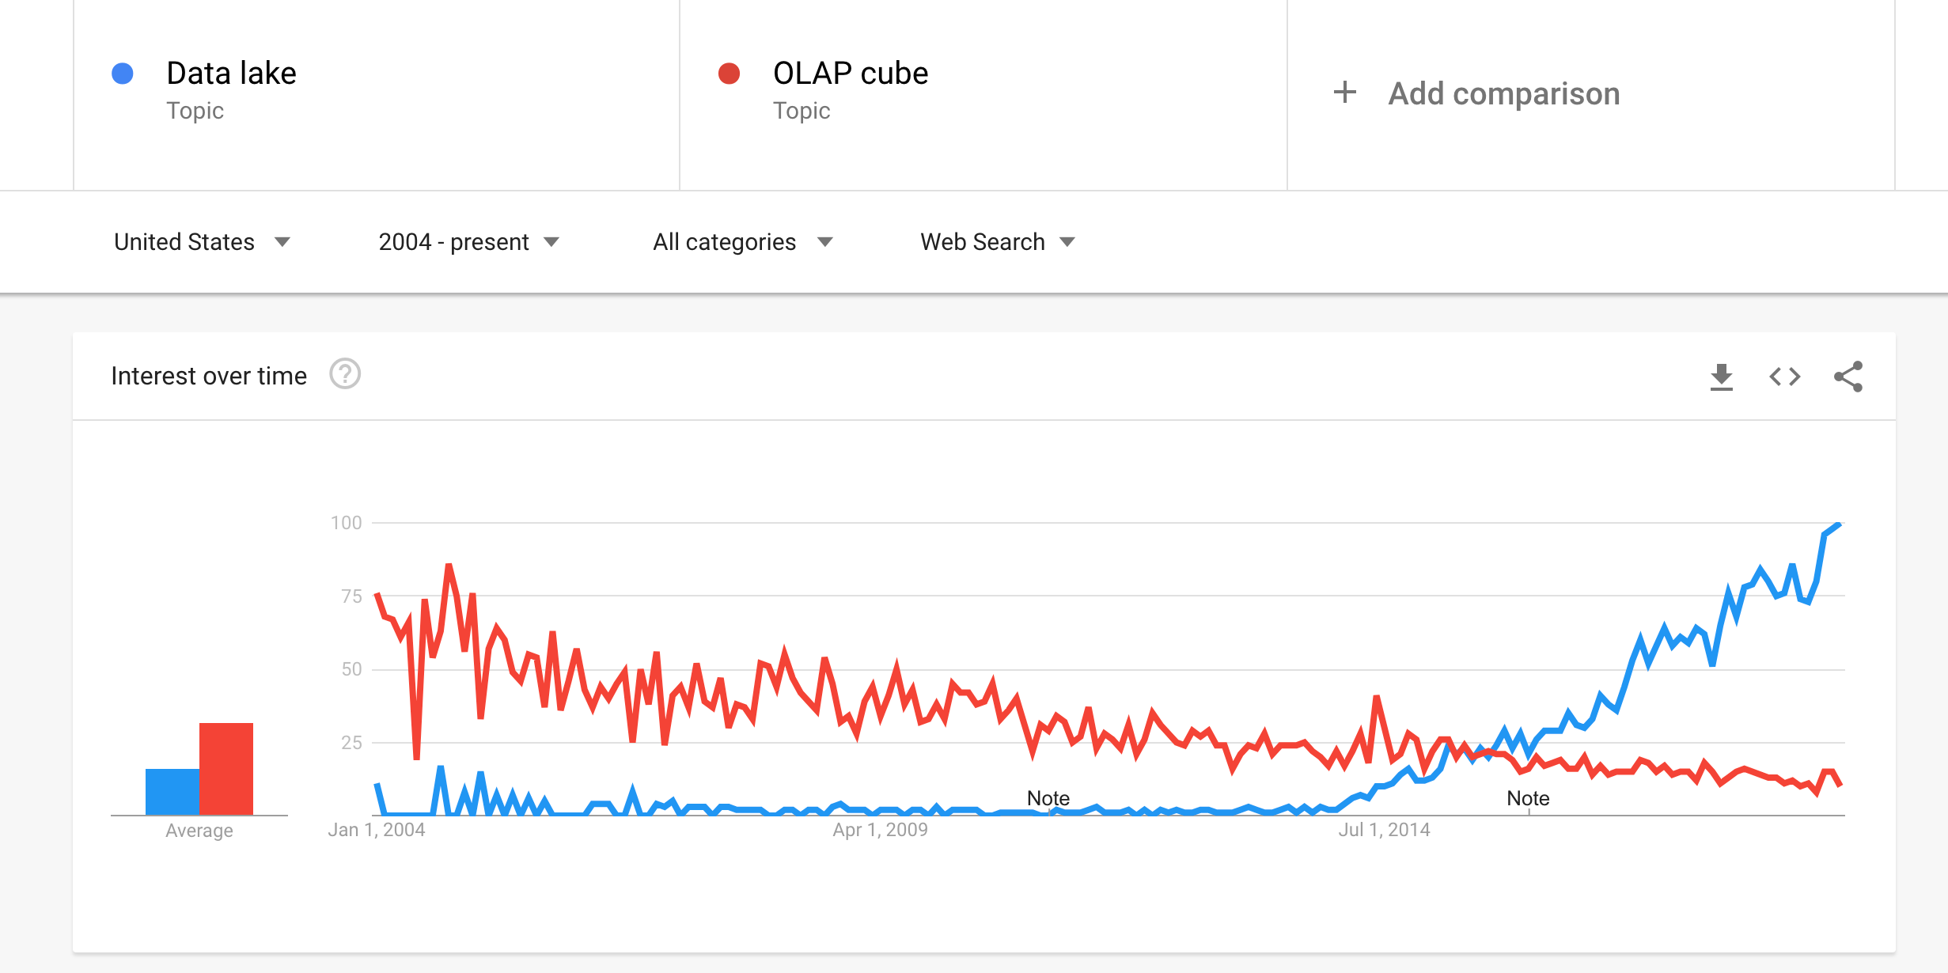
Source: Google Trends
Notes:
https://trends.google.com/trends/explore?date=all&geo=US&q=%2Fm%2F0136zzks,%2Fm%2F031sdk

Slide 33
A lead scoring model today
Fully managed by Redshift, Snowflake, BigQuery for $10k
Usage data
Lead enrichment
Analytics + data science platform
Distribute list to sales reps
Data warehouse
Sales interactions
Notes:
Sources:
http://www.oracle.com/us/corporate/analystreports/esg-getting-real-bigdata-2228170.pdf
https://www.cooladata.com/blog/true-cost
Look at all these things investors want. These are the ways that investors evaluate startups. It’s intimidating.

Slide 34
















Slide 35
A lead scoring model today
Fully managed by Fivetran, Stitch, Segment for $10k
Usage data
Lead enrichment
Analytics + data science platform
Distribute list to sales reps
Data warehouse
Sales interactions
Notes:
Sources:
http://www.oracle.com/us/corporate/analystreports/esg-getting-real-bigdata-2228170.pdf
https://www.cooladata.com/blog/true-cost
Look at all these things investors want. These are the ways that investors evaluate startups. It’s intimidating.

Slide 36
A lead scoring model today
$0 for Jupyter, RStudio, or hosted solution
Usage data
Lead enrichment
Analytics + data science platform
Distribute list to sales reps
Data warehouse
Sales interactions
Notes:
Sources:
http://www.oracle.com/us/corporate/analystreports/esg-getting-real-bigdata-2228170.pdf
https://www.cooladata.com/blog/true-cost
Look at all these things investors want. These are the ways that investors evaluate startups. It’s intimidating.

Slide 37
A lead scoring model today
$0 for Jupyter, RStudio, or hosted solution
Usage data
Lead enrichment
Analytics + data science platform
Distribute list to sales reps
Data warehouse
Sales interactions
Notes:
Sources:
http://www.oracle.com/us/corporate/analystreports/esg-getting-real-bigdata-2228170.pdf
https://www.cooladata.com/blog/true-cost
Look at all these things investors want. These are the ways that investors evaluate startups. It’s intimidating.

Slide 38
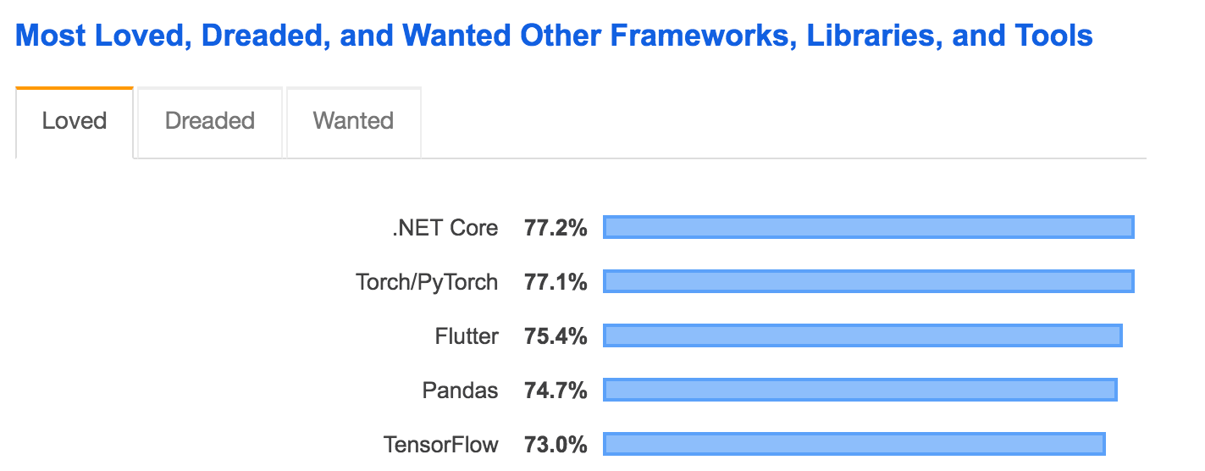
Sources: Stack Overflow Developer Survey

Slide 39
Sources: Stack Overflow Developer Survey

Slide 40
A lead scoring model today
$0 for Scikit-learn, PyTorch, TensorFlow, etc...
Usage data
Lead enrichment
Analytics + data science platform
Distribute list to sales reps
Data warehouse
Sales interactions
Notes:
Sources:
http://www.oracle.com/us/corporate/analystreports/esg-getting-real-bigdata-2228170.pdf
https://www.cooladata.com/blog/true-cost
Look at all these things investors want. These are the ways that investors evaluate startups. It’s intimidating.

Slide 41
To sell to the Glengarry leads...
Set up point-and-click ETL
1...
Notes:
Source: https://medium.com/signalfire-fund/top-5-metrics-vcs-look-at-for-series-a-b-c-c6a0171fd200
Look at all these things investors want. These are the ways that investors evaluate startups. It’s intimidating.

Slide 42
To sell to the Glengarry leads...
Set up point-and-click ETL
1...
Set up point-and-click warehouses
2...
Notes:
Source: https://medium.com/signalfire-fund/top-5-metrics-vcs-look-at-for-series-a-b-c-c6a0171fd200
Look at all these things investors want. These are the ways that investors evaluate startups. It’s intimidating.

Slide 43
To sell to the Glengarry leads...
Set up point-and-click ETL
1...
Set up point-and-click warehouses
2...
Tweak an open-source model
3...
Notes:
Source: https://medium.com/signalfire-fund/top-5-metrics-vcs-look-at-for-series-a-b-c-c6a0171fd200
Look at all these things investors want. These are the ways that investors evaluate startups. It’s intimidating.

Slide 44
To sell to the Glengarry leads...
Set up point-and-click ETL
1...
Set up point-and-click warehouses
2...
Tweak an open-source model
3...
The sales team has to use our results
4...
Notes:
Source: https://medium.com/signalfire-fund/top-5-metrics-vcs-look-at-for-series-a-b-c-c6a0171fd200
Look at all these things investors want. These are the ways that investors evaluate startups. It’s intimidating.

Slide 45
To sell to the Glengarry leads...
We solve hard business problems with analytical reasoning and existing frameworks
Notes:
Source: https://medium.com/signalfire-fund/top-5-metrics-vcs-look-at-for-series-a-b-c-c6a0171fd200
Look at all these things investors want. These are the ways that investors evaluate startups. It’s intimidating.

Slide 46
To sell to the Glengarry leads...
Analytical and business expertise
Engineering and development
Statistics
Notes:
Source: https://medium.com/signalfire-fund/top-5-metrics-vcs-look-at-for-series-a-b-c-c6a0171fd200
Look at all these things investors want. These are the ways that investors evaluate startups. It’s intimidating.

Slide 47
The cost of data science
$500k a year
Months of work
A lot of expertise
$20k a year
2014
2019

Slide 48
The cost of data science
$500k a year
Months of work
A lot of expertise
$20k a year
30 minutes of work
2014
2019

Slide 49
The cost of data science
$500k a year
Months of work
A lot of expertise
$20k a year
30 minutes of work
Analytical expertise
2014
2019

Slide 50
Any company can set up data science infrastructure in under an hour.

Slide 51

Data science for everyone!

Slide 52
Data science for everyone?

Slide 53
We aren’t there yet

Slide 54
A story
about hiring

Slide 55


Slide 56
Company headcount
2018
2019 target

Slide 57
This company
Who we hire will define what our company becomes.
Notes:
Source: https://pmarchive.com/guide_to_startups_part4.html
We all know how important this is. I won’t bore you with too many details here, just a couple quotes from people who you probably trust way more than me.

Slide 58
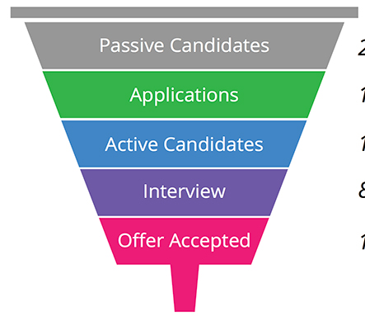
Source: Jobvite

Slide 59
What did they find?
Getting promoted is good
Notes:
Source: https://medium.com/signalfire-fund/top-5-metrics-vcs-look-at-for-series-a-b-c-c6a0171fd200
Look at all these things investors want. These are the ways that investors evaluate startups. It’s intimidating.

Slide 60
What did they find?
Getting promoted is good
Junior hires tend to get promoted
Notes:
Source: https://medium.com/signalfire-fund/top-5-metrics-vcs-look-at-for-series-a-b-c-c6a0171fd200
Look at all these things investors want. These are the ways that investors evaluate startups. It’s intimidating.

Slide 61
What did they find?
Getting promoted is good
Junior hires tend to get promoted
Hire more junior people
Notes:
Source: https://medium.com/signalfire-fund/top-5-metrics-vcs-look-at-for-series-a-b-c-c6a0171fd200
Look at all these things investors want. These are the ways that investors evaluate startups. It’s intimidating.

Slide 62


Slide 63
A data scientist stepped in and averted a potential disaster.

Slide 64
How did this almost happen?

Slide 65
There wasn’t enough of this in the room
Analytical and business expertise
Engineering and development
Statistics

Slide 66
Analytical and business expertise
And no amount of these would have helped
Engineering and development
Statistics

Slide 67
No matter how good the data…

Slide 68
No matter how good the data…
No matter how good the model...

Slide 69
No matter how good the data…
No matter how good the model...
This was going to end poorly.

Slide 70


Slide 71
This is was just one example.

Slide 72
This is was just one example.
How many bad decisions get made?

Slide 73
This is was just one example.
How many bad decisions get made?
How many opportunities get missed?

Slide 74
accessible.
We’ve made data science much more aaaaaaa
How do we make data science more foooooo
effective?

Slide 75
accessible.
We’ve made data science much more aaaaaaa
How do we make data science more foooooo
effective?

Slide 76
Put analytical expertise in every room.

Slide 77
Is that radical?

Slide 78
A story about
engineering

Slide 79
U.S. employment
689k
707k
Computer programmers
Application developers
Source: St. Louis Fed
Notes:
https://nces.ed.gov/programs/digest/d17/tables/dt17_322.10.asp?current=yes

Slide 80
U.S. employment
689k
707k
Building infrastructure
Building products
Source: St. Louis Fed
Notes:
https://nces.ed.gov/programs/digest/d17/tables/dt17_322.10.asp?current=yes

Slide 81





Slide 82
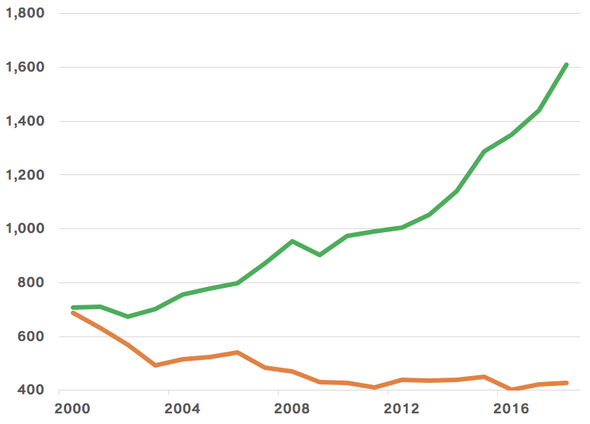
U.S. employment (1,000s)
Application developers
Computer programmers
Source: St. Louis Fed
Notes:
https://fred.stlouisfed.org/series/LEU0254477100A
https://fred.stlouisfed.org/series/LEU0254477200A

Slide 83
The frameworks and infrastructure are good enough that specialized application developers are valuable

Slide 84

Ian Blumenfeld
@ianblu1
Data science is where web development was 15 years ago.
Notes:
Source: https://pmarchive.com/guide_to_startups_part4.html
We all know how important this is. I won’t bore you with too many details here, just a couple quotes from people who you probably trust way more than me.

Slide 85
Data science frameworks and infrastructure...
$500k a year
Months of work
A lot of expertise
$20k a year
30 minutes of work
Analytical expertise
2014
2019

Slide 86
...can now make analytical experts valuable
Analytical and business expertise
Engineering and development
Statistics
Notes:
Source: https://medium.com/signalfire-fund/top-5-metrics-vcs-look-at-for-series-a-b-c-c6a0171fd200
Look at all these things investors want. These are the ways that investors evaluate startups. It’s intimidating.

Slide 87
In data science as in engineering:
Most work will be the where the business and technology intersect

Slide 88
The future of data science is specialization
Analytical expertise
Data science developers

Slide 89
But how?

Slide 90
Are there people shaped like this?
Analytical and business expertise
Engineering and development
Statistics
Notes:
Source: https://medium.com/signalfire-fund/top-5-metrics-vcs-look-at-for-series-a-b-c-c6a0171fd200
Look at all these things investors want. These are the ways that investors evaluate startups. It’s intimidating.

Slide 91
Bachelor’s degrees conferred, 2005-2015
3.0m
2.1m
STEM
Social sciences
Source: National Center for Education Statistics
Notes:
https://nces.ed.gov/programs/digest/d17/tables/dt17_322.10.asp?current=yes

Slide 92
Median earning by degree
$100k
Math, CS
$80k
Physics
Stats
Economics
$60k
Political science
History
Sociology
Psychology
$40k
STEM
Social sciences
Source: Georgetown Center on Education and the Workforce
Notes:
https://cew.georgetown.edu/cew-reports/valueofcollegemajors/#explore-data

Slide 93
Bachelor’s degrees by gender, 2015-2016
100%
61%
50%
26%
STEM
Social sciences
Source: National Center for Education Statistics
Notes:
https://nces.ed.gov/programs/digest/d17/tables/dt17_318.30.asp

Slide 94
The next frontier for data science
We’ve built tools with a lot of potential
Notes:
Source: https://medium.com/signalfire-fund/top-5-metrics-vcs-look-at-for-series-a-b-c-c6a0171fd200
Look at all these things investors want. These are the ways that investors evaluate startups. It’s intimidating.

Slide 95
The next frontier for data science
We’ve built tools with a lot of potential
We need help to make them valuable
Notes:
Source: https://medium.com/signalfire-fund/top-5-metrics-vcs-look-at-for-series-a-b-c-c6a0171fd200
Look at all these things investors want. These are the ways that investors evaluate startups. It’s intimidating.

Slide 96
The next frontier for data science
We’ve built tools with a lot of potential
We need help to make them valuable
Less-technical analytical thinkers will
Notes:
Source: https://medium.com/signalfire-fund/top-5-metrics-vcs-look-at-for-series-a-b-c-c6a0171fd200
Look at all these things investors want. These are the ways that investors evaluate startups. It’s intimidating.

Slide 97
The next frontier for data science
We’ve built tools with a lot of potential
We need help to make them valuable
Less-technical analytical thinkers will
Our challenge: How do we welcome them?
Notes:
Source: https://medium.com/signalfire-fund/top-5-metrics-vcs-look-at-for-series-a-b-c-c6a0171fd200
Look at all these things investors want. These are the ways that investors evaluate startups. It’s intimidating.

Slide 98
BACKUP

Slide 99
2014!
Business app A
Business app B
Analytics + data science platform
Data warehouse
Business app C
Notes:
Sources:
http://www.oracle.com/us/corporate/analystreports/esg-getting-real-bigdata-2228170.pdf
https://www.cooladata.com/blog/true-cost
Look at all these things investors want. These are the ways that investors evaluate startups. It’s intimidating.

Slide 100
Why?
How do we make sure reps see the leads?
1...
How do we test our new model against the old one?
2...
How much detail about the score do we expose?
3...
How do make sure it’s not self-reinforcing?
4...
Notes:
Source: https://medium.com/signalfire-fund/top-5-metrics-vcs-look-at-for-series-a-b-c-c6a0171fd200
Look at all these things investors want. These are the ways that investors evaluate startups. It’s intimidating.

Slide 101
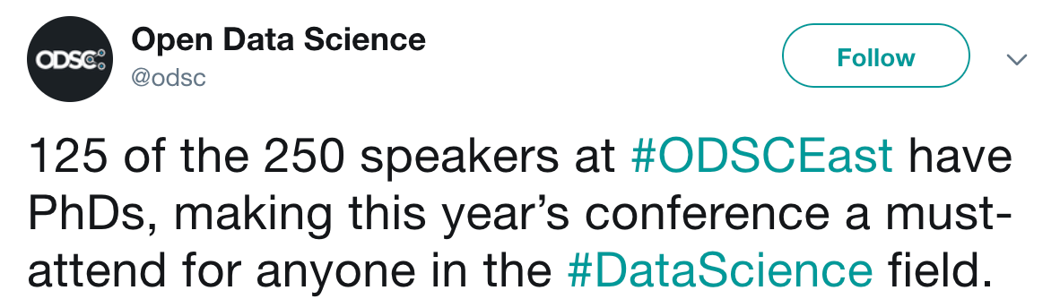

Slide 102
Analytical and business expertise
Engineering and development
Statistics

Slide 103
Analytical and business expertise
Engineering and development
Statistics

Slide 104
Data science at Mode:
Solving hard business problems with analytical reasoning and existing frameworks

Slide 105
Four big changes
Falling compute costs
1...
The cloud
2...
Data standardization
3...
Move to open source
4...
Notes:
Source: https://medium.com/signalfire-fund/top-5-metrics-vcs-look-at-for-series-a-b-c-c6a0171fd200
Look at all these things investors want. These are the ways that investors evaluate startups. It’s intimidating.

Slide 106
Jumping to the end...

Slide 107
It’s time to update our definition of a data scientist

Slide 108
Analytical and business expertise
Engineering and development
Statistics

Slide 109
Analytical and business expertise
Engineering and development
Statistics

